Slide 1
Heart disease dataset: data exploration and analysis
Brandon May
DSC 530 – Final project

Slide 2
Description of dataset
Found at https://www.kaggle.com/ronitf/heart-disease-uci
Collection of data from multiple sources to classify heart disease based on variety of factors.
Kaggle user states that the Cleveland Clinic Database has been used solely for machine learning purposes.
Dataset created by four different creators listed below.
Dummy variables replaced personally identifiable information.
Creators:
Hungarian Institute of Cardiology. Budapest: Andras Janosi, M.D.
University Hospital, Zurich, Switzerland: William Steinbrunn, M.D.
University Hospital, Basel, Switzerland: Matthias Pfisterer, M.D.
V.A. Medical Center, Long Beach and Cleveland Clinic Foundation: Robert Detrano, M.D., Ph.D.

Slide 3
Background information
Coronary artery disease is the presence of atherosclerotic plaques in the coronary arteries around the heart.
More common as someone ages.
Risk factors include High Blood Pressure, Diabetes/Pre-Diabetes, High Cholesterol, Age, and Gender to name a few variables.
If someone is diagnosed with this based on angiography (pictures to quantify the amount of narrowing in the blood vessel), typically the value would be a stenosis >50%. At this point, there may be considerations for stenting and/or aggressive lifestyle modifications (i.e. controlling BP, blood sugar, cholesterol levels with medications).

Slide 4
Dataset background
CAD is more common as individuals age.
The Target Variable is CAD Presence or Absence
0 = Absence (<50% Angiographic Narrowing)
1 = Presence (>50% Angiographic Narrowing)
The variables in question as potential predictors of CAD in this dataset I plan to use are:
Age
Cholesterol Level (mg/dL)
Resting Systolic BP (mmHg) On Admission to Hospital
Fasting Blood Sugar (Coded Categorically – 0 = <120 and 1 = >120)
Resting EKG Findings (Coded Categorically)
0 = Normal
1 = ST/T-wave abnormalities (T wave inversions or ST elevation/depression)
2 = Showing probable or definite LVH
Number of Vessels Fluoroscopically Identified
Presence of Exercise Induced Angina
Type of Chest Pain Experiences
0 = Asymptomatic
1 = Typical Angina
2 = Atypical Angina
3 = Non-Anginal Pain

Slide 5
Questions to address
Hypothesis: The presence of coronary artery disease can be reliably predicted using combination of age, cholesterol, systolic resting blood pressure, whether fasting blood sugar is in pre-diabetic or diabetic range, findings on EKGs, and angina type.
Predictions:
As the number of vessels imaged angiographically increase, there will be a positive correlation with CAD presence.
The greater the age, cholesterol level, and resting BP will have a positive correlation with the presence of CAD and will be a stronger association than variables individually.
Those with fasting blood sugar >120 and those with typical angina will have a significant positive correlation predictive of CAD.
The presence of exercise-induced angina coupled with higher cholesterol, resting BP, and fasting blood sugar will have a positive correlation.
As the number of angiographically identified vessels, increase, this will correlate positively with the presence of CAD.
For EKG findings, those who have EKG findings consistent with possible ischemia, those individuals will have a stronger associated with CAD than those who have LVH criteria (those with enlarged hearts) on their EKG.

Slide 6
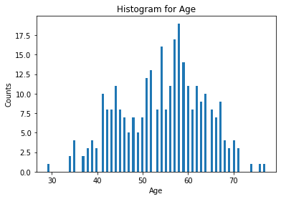
Analysis - HISTOGRAMS

Slide 7
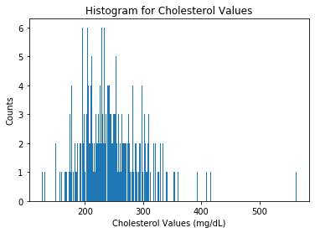
Analysis - HISTOGRAMS

Slide 8
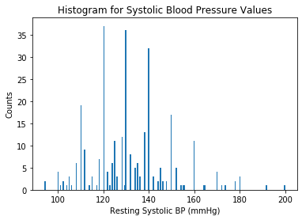
Analysis - HISTOGRAMS

Slide 9
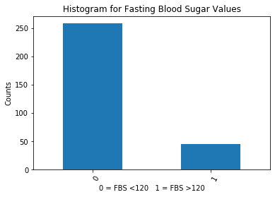
Analysis - HISTOGRAMS

Slide 10
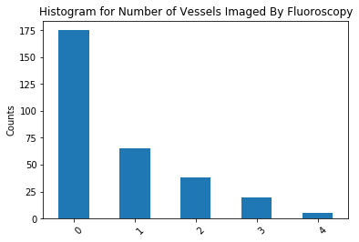
Analysis - histograms

Slide 11
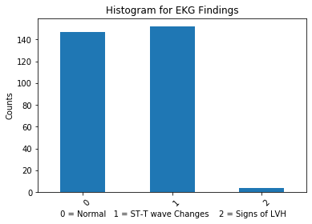
Analysis - HISTOGRAMS

Slide 12
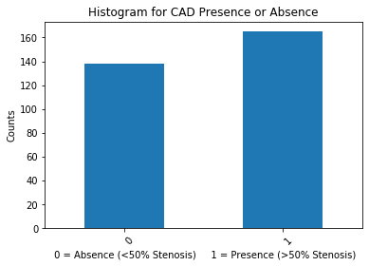
Analysis - HISTOGRAMS

Slide 13
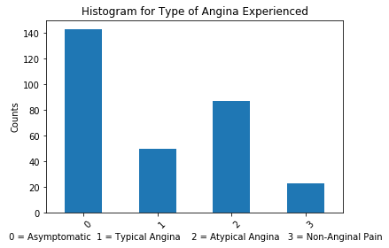
Analysis - histograms

Slide 14
Histogram conclusions
The age, cholesterol, and resting BP histograms indicated possible outliers on the very extremes.
In the age variable there was a 29 year old male who did have CAD. Resting BP and cholesterol for this data point were 130 and 204 respectively. These vitals are WNL and since the individual did have proven CAD, I would not consider this an outlier.
For the cholesterol variables, there appears to be a wide range and significantly elevated cholesterol levels in the 400s and 500s. However, this can be due to a genetic condition and would be predictive of CAD so would not discard these as outliers.
For the resting BP variables, likewise, there is a wide range of normal. There were some significantly elevated BPs and lower BPs. These are outside the normal range but can be commonly seen. The high BP especially can be seen in acute coronary events and this BP variable was determined upon admission to the hospital. These would impact the prediction on CAD presence, so once again would not discard these are outliers.
The histograms for the categorical variables of CAD presence, EKG findings, and blood sugar results do not appear to have any significant outliers due to the limited categories available.
The CAD Presence variable seems to have almost equal numbers which could represent a good sample.

Slide 15
DESCRIPTIVE STATISTICS
Age Variable:
Count: 303
Mean: 54.4
Std: 9.1
Min: 29
25%: 47.5
50%: 55
75%: 61
Max: 77
Mode: 58
Cholesterol Variable
Count: 303
Mean: 246.2
Std: 51.8
Min: 126
25%: 211
50%: 240
75%: 274.5
Max: 564.
3 Separate Modes: 197, 204, 234
Systolic BP Variable:
Count: 303
Mean: 131.6
Std: 17.5
Min: 94
25%: 120
50%: 130
75%: 140
Max: 200
Mode: 120
Resting ECG Variable
Count: 303
3 Unique Values
Mode: 1 with Frequency of 152
Blood Sugar Variable:
Count: 303
Unique: 2 Values
Freq: 258
Mode: 0
Exercised Induced Angina Variable
Count: 303
Mean: 0.32673
STD: 0.469794
Max: 1.0
Mode: 0
Number of Vessels Variable
Count: 303
Mean: 0.7293
STD: 1.0226
Max: 4
Mode: 0
CAD Presence Variable
Count: 303
Top Value: 1 with Frequency of 165

Slide 16
Probability mass functions
For our PMF’s, we will compare the probability of being diagnosed with CAD vs. being diagnosed without CAD and their cholesterol values, blood pressure, and age as three separate graphs.

Slide 17
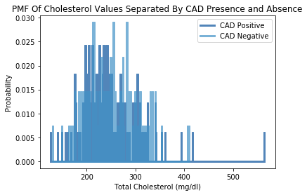
Probability mass functions

Slide 18
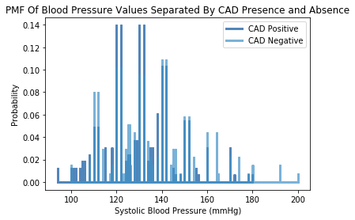
Probability mass functions

Slide 19
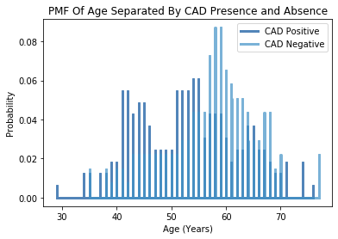
Probability mass functions

Slide 20
Probability mass functions
Insights From The Three Separate PMFs:
For Cholesterol, there actually appears to be a more significant proportion of lower cholesterols with CAD identified. This is opposed to those with higher cholesterols and CAD negative.
For BP, there was a significant proportion of individuals positive for CAD at normal blood pressures.
For Age, there was a significant proportion of individuals negative for CAD at higher age ranges.
Based on these PMFs, the data may not be representative of the population.
As people have higher cholesterol, higher BP, and age, they have an increased likelihood of having CAD.
These graphs indicate the opposite of that based on the probability mass functions meaning that the sample size could have been biased to include those who were more likely to not have CAD.

Slide 21
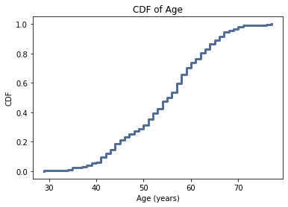
Cumulative distribution functions

Slide 22
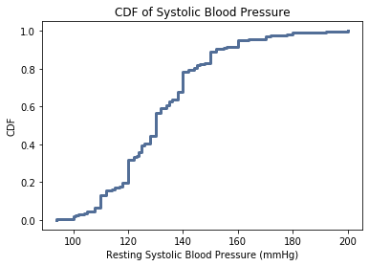
Cumulative distribution functions

Slide 23
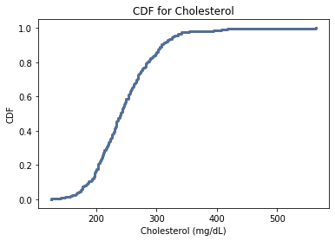
Cumulative distribution functions

Slide 24
CDF Interpretation
For the age variable, the CDF is more or less a straight line with a good distribution of values. Comparing this with the histogram, this would appear to be a normal distribution.
For the cholesterol variable, the middle line of the curve is steeper than the age variable indicating higher frequency of those values. This would suggest that there are a significant amount of higher values.
This could impact our analysis as it seems that our dataset has higher baseline cholesterol values so there would already be an increased likelihood of having CAD given those levels.

Slide 25
Analytic and modeling distributions
Given that much of my data is regarding health-related demographic data, I chose a normal probability plot for my three numeric variables.

Slide 26
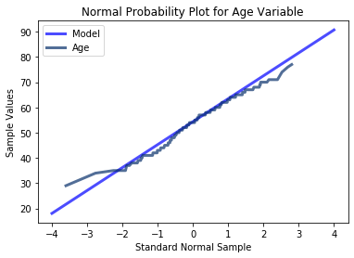
Normal Probability plot

Slide 27
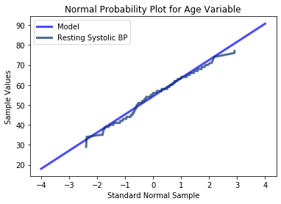
Normal probability plot

Slide 28
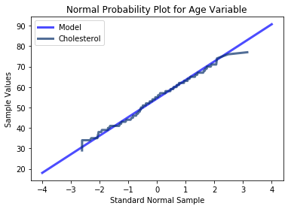
Normal probability plot

Slide 29
Normal probability plot conclusions
The three variables of age, systolic blood pressure, and cholesterol all appear to follow a normal distribution. However, at the extremes of the model, there appears to be significant variability in the tails.
I would conclude here that for the middle ranges, our sample dataset appears to follow a normal distribution but for the extreme values in the tails of all three of the different variables, this model may not be entirely appropriate.

Slide 30
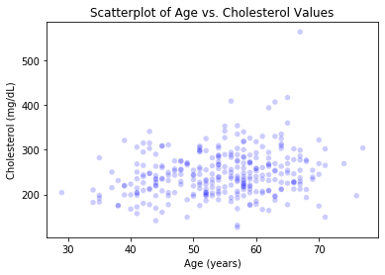
SCATTERPLOTs
There appears to be a fairly weak positive correlation here between age and cholesterol values.

Slide 31
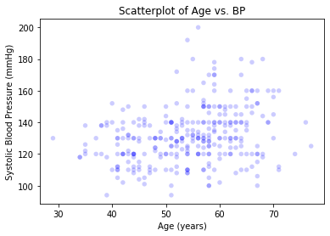
SCATTERPLOTS
This graph suggest a positive correlation of age and blood pressure. As one ages, blood pressure increases.

Slide 32
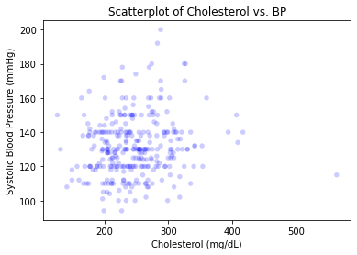
SCATTERPLOTS
There does not appear to be a strong correlation between cholesterol and blood pressure.

Slide 33
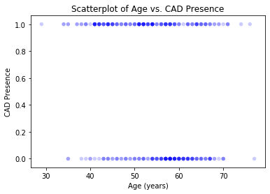
SCATTERPLOTS
This also confirms our initial PMF in that in this distribution and dataset, there seemed to be a higher amount of individuals with CAD at younger ages and a higher amount of individuals without CAD at older ages (opposite what we would logically think).

Slide 34
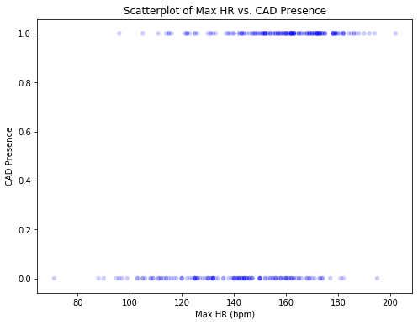
SCATTERPLOTS
Looking at this graph, it actually appears that Max HR on Stress Testing at a HIGHER level seems to be correlated with CAD presence judging by the overlap of values with the value of 1 (CAD Presence).

Slide 35
Scatterplot interpretations
I used Spearman Correlation for these three scatterplots since it is more robust in the presence of outliers which we have determined, there are some extreme values (not necessarily outliers) but would not necessarily follow a truly normal distribution.
Spearman’s Correlation Results:
Age and Cholesterol = 0.1957
Age and BP = 0.2856
Cholesterol and BP = 0.1265
Based on these results, there appears to be a small to moderate positive correlation between all of these variables with the strongest relationship between age and systolic blood pressure. This would suggest that as age increases both cholesterol and BP increase. As cholesterol increases, BP increases.
This does NOT imply causation merely an association between these variables. The association is of small to moderate strength.

Slide 36
Correlation Plot
 | age | sex | cp | Trestbps | chol | fbs | restecg | thalach | exang | oldpeak | slope | ca | thal | target
age | 1.000000 | -0.099131 | -0.087494 | 0.285617 | 0.195786 | 0.113978 | -0.132769 | -0.398052 | 0.089679 | 0.268291 | -0.184048 | 0.340955 | 0.087254 | -0.238400
sex | -0.099131 | 1.000000 | -0.062041 | -0.052941 | -0.151342 | 0.045032 | -0.048389 | -0.039868 | 0.141664 | 0.100715 | -0.025010 | 0.119368 | 0.250821 | -0.280937
cp | -0.087494 | -0.062041 | 1.000000 | 0.035413 | -0.091721 | 0.089775 | 0.065640 | 0.324013 | -0.418256 | -0.161449 | 0.159478 | -0.216006 | -0.207840 | 0.460860
trestbps | 0.285617 | -0.052941 | 0.035413 | 1.000000 | 0.126562 | 0.151984 | -0.125841 | -0.040407 | 0.052918 | 0.154267 | -0.086570 | 0.090140 | 0.059673 | -0.121593
chol | 0.195786 | -0.151342 | -0.091721 | 0.126562 | 1.000000 | 0.018463 | -0.161933 | -0.046766 | 0.091514 | 0.045260 | -0.012551 | 0.111981 | 0.083628 | -0.120888
fbs | 0.113978 | 0.045032 | 0.089775 | 0.151984 | 0.018463 | 1.000000 | -0.081508 | -0.014273 | 0.025665 | 0.028363 | -0.045786 | 0.134513 | -0.006737 | -0.028046
restecg | -0.132769 | -0.048389 | 0.065640 | -0.125841 | -0.161933 | -0.081508 | 1.000000 | 0.087863 | -0.077399 | -0.077372 | 0.113661 | -0.097862 | -0.010982 | 0.148612
thalach | -0.398052 | -0.039868 | 0.324013 | -0.040407 | -0.046766 | -0.014273 | 0.087863 | 1.000000 | -0.400860 | -0.433241 | 0.436968 | -0.257347 | -0.160581 | 0.428370
exang | 0.089679 | 0.141664 | -0.418256 | 0.052918 | 0.091514 | 0.025665 | -0.077399 | -0.400860 | 1.000000 | 0.297173 | -0.274475 | 0.162025 | 0.247113 | -0.436757
oldpeak | 0.268291 | 0.100715 | -0.161449 | 0.154267 | 0.045260 | 0.028363 | -0.077372 | -0.433241 | 0.297173 | 1.000000 | -0.594847 | 0.224895 | 0.255026 | -0.421487
slope | -0.184048 | -0.025010 | 0.159478 | -0.086570 | -0.012551 | -0.045786 | 0.113661 | 0.436968 | -0.274475 | -0.594847 | 1.000000 | -0.099901 | -0.154886 | 0.371460
ca | 0.340955 | 0.119368 | -0.216006 | 0.090140 | 0.111981 | 0.134513 | -0.097862 | -0.257347 | 0.162025 | 0.224895 | -0.099901 | 1.000000 | 0.189103 | -0.457607
thal | 0.087254 | 0.250821 | -0.207840 | 0.059673 | 0.083628 | -0.006737 | -0.010982 | -0.160581 | 0.247113 | 0.255026 | -0.154886 | 0.189103 | 1.000000 | -0.403299
target | -0.238400 | -0.280937 | 0.460860 | -0.121593 | -0.120888 | -0.028046 | 0.148612 | 0.428370 | -0.436757 | -0.421487 | 0.371460 | -0.457607 | -0.403299 | 1.000000

Slide 37
Correlation insights
Age and CAD Presence: -0.238 with P-value: 2.74e-5
Cholesterol and CAD Presence: -0.120 with P-value: 0.035
BP and CAD Presence: -0.1215 with P-value: 0.034
Exercise Induced Angina and CAD Presence: -0.4367 with P-value: 1.5 e-15
Resting EKG Changes and CAD Presence: 0.1486 with P-value: 0.009
There is a negative correlation between Age, Cholesterol, BP, Exercise Induced Angina Presence with CAD Presence. All of these are statistically significant with a P value of <0.05.
The strongest correlation is the r value of -0.43 for Exercise Induced Angina and CAD Presence which is opposite from our hypothesis. The next strongest correlation is the r of -0.238 for age and CAD presence.
All of these values are opposite my initial hypotheses.

Slide 38
Hypothesis testing
After running Hypothesis Testing between Age and Cholesterol, Age and BP, and Cholesterol and BP, all got significant P values of 0.002, 0.0, and 0.0 respectively.
This indicates that a statistically significant relationship based on these correlations is likely and unlikely to have occurred by chance.

Slide 39
Regression analyses
I chose logistical regression analyses since the CAD Presence or Absence variable is categorical (0 being Absent, 1 being Present) and logistical regression is good for predicting binary outcomes.

Slide 40
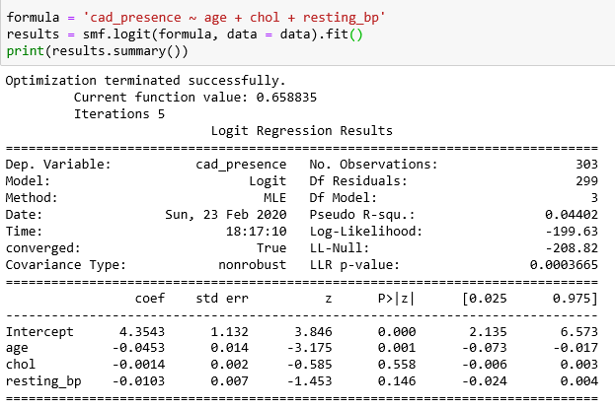

Regression analysis FOR AGE/CHOL/BP
ODDS Ratios:
Here, age, cholesterol, and BP are negatively correlated with CAD Presence and the Odds Ratios are all less than 1.

Slide 41
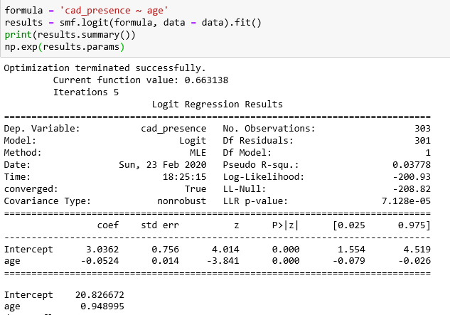
Regression analysis FOR AGE
There is a statistically significant negative correlation between age and CAD presence with an odds ratio <1 indicating increasing age is less likely to be associated with CAD presence.

Slide 42

Regression analysis FOR cholesterol
There is a very small negative correlation between cholesterol and CAD presence with an odds ratio <1 indicating increasing cholesterol is less likely to be associated with CAD presence. It is not statistically significant.

Slide 43
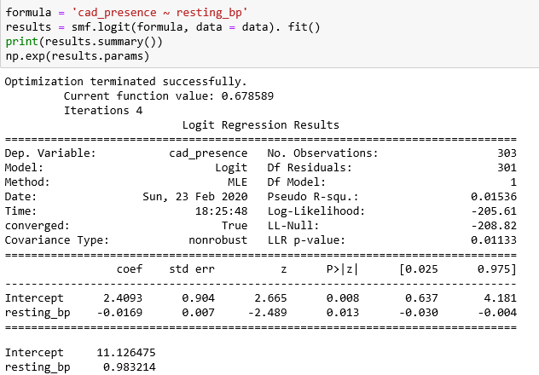
Regression analysis FOR BP
There is a small statistically significant negative correlation between BP and CAD presence with an odds ratio <1 indicating increasing BP is less likely to be associated with CAD presence.

Slide 44
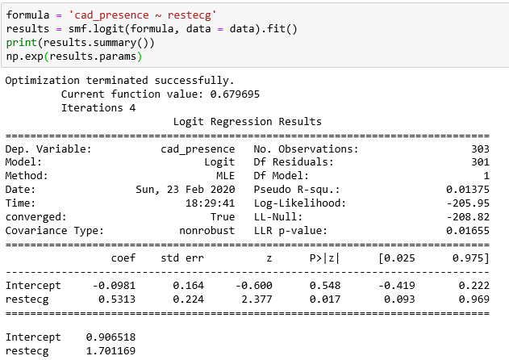
Regression analysis FOR RESTING EKG CHANGES
There is a positive statistically significant relationship between resting EKG changes and CAD Presence.

Slide 45
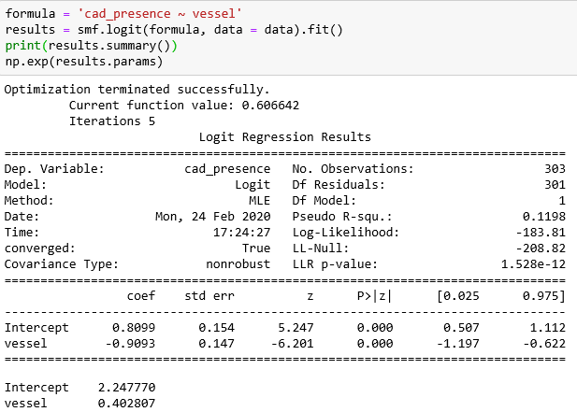
Regression analysis FOR number of vessels
Number of vessels has a lower likelihood ratio of 0.40 indicating CAD presence less likely as number of vessels increased.

Slide 46
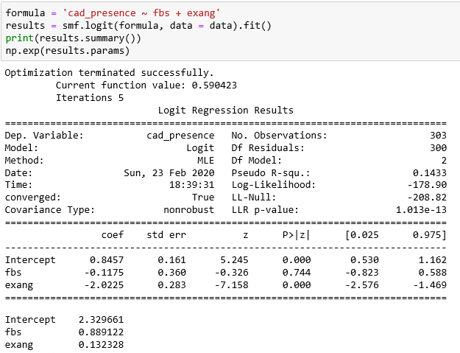
Regression analysis FOR Blood sugar and exercise induced angina
There statistically significant negative relationship between exercise induced angina when controlled for blood sugar with a low odds ratio indicating absence of exercise induced angina is more likely to be associated with CAD presence.

Slide 47
Final conclusions
Logically, many of the findings here disproved my hypotheses.
In general, as one ages, has higher cholesterol, and higher BP, one is more likely to have CAD (these are CAD risk factors).
The results indicate the opposite and the inverse of this relationship.
EKG findings are associated with CAD presence (Odds Ratio 1.7), though since this variable was categorical, unsure how to interpret whether this is accounting for ST changes of LVH on EKGs.
Possible Reason: Sample was not evenly distributed and skewed towards a population with early CAD at young ages.
Specific hypotheses regarding the type of symptoms and correlation with cholesterol, BP, and age and the association between typical angina/fasting blood sugars >120 are unable to be evaluated at this time due to lack of knowledge of how to segment the dataset and to get appropriate regression or machine learning analysis.

